Slide 1

Over Prescribing & overdose
Christian Alsider

Slide 2

Introduction
In the past addictions and overdoses were seen as “social class” problems.
The introduction of Oxycodone changed that. The dope dealer moved from the trap house to the doctor's office. Suddenly overdoses were no longer the panda eye junkie from the after-school PSA, they are high functioning members of society who no one suspects has an addiction.
Was it the change in the prescribing habits of our providers?

Slide 3

How did we get here?
1997 Oxycodone hits market
2000
Purdue profits 1.1 billion
2007
Admits oxy addicting
2002
Time release broken
2011
New unbreakable formula
2015
Fentanyl hits TN
2017
Opiate epidemic declared
https://www.ncbi.nlm.nih.gov/pmc/articles/PMC2622774/

Slide 4
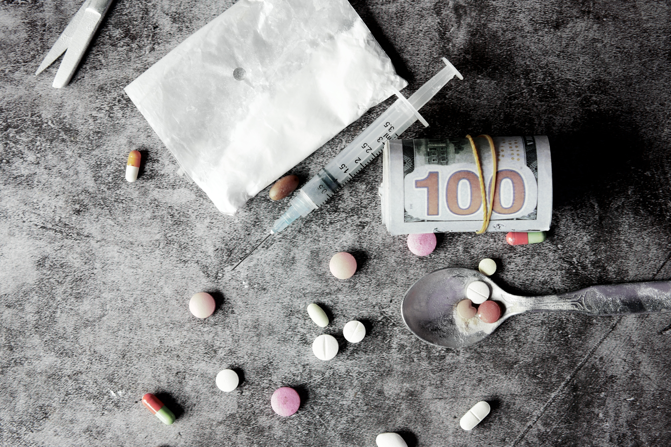
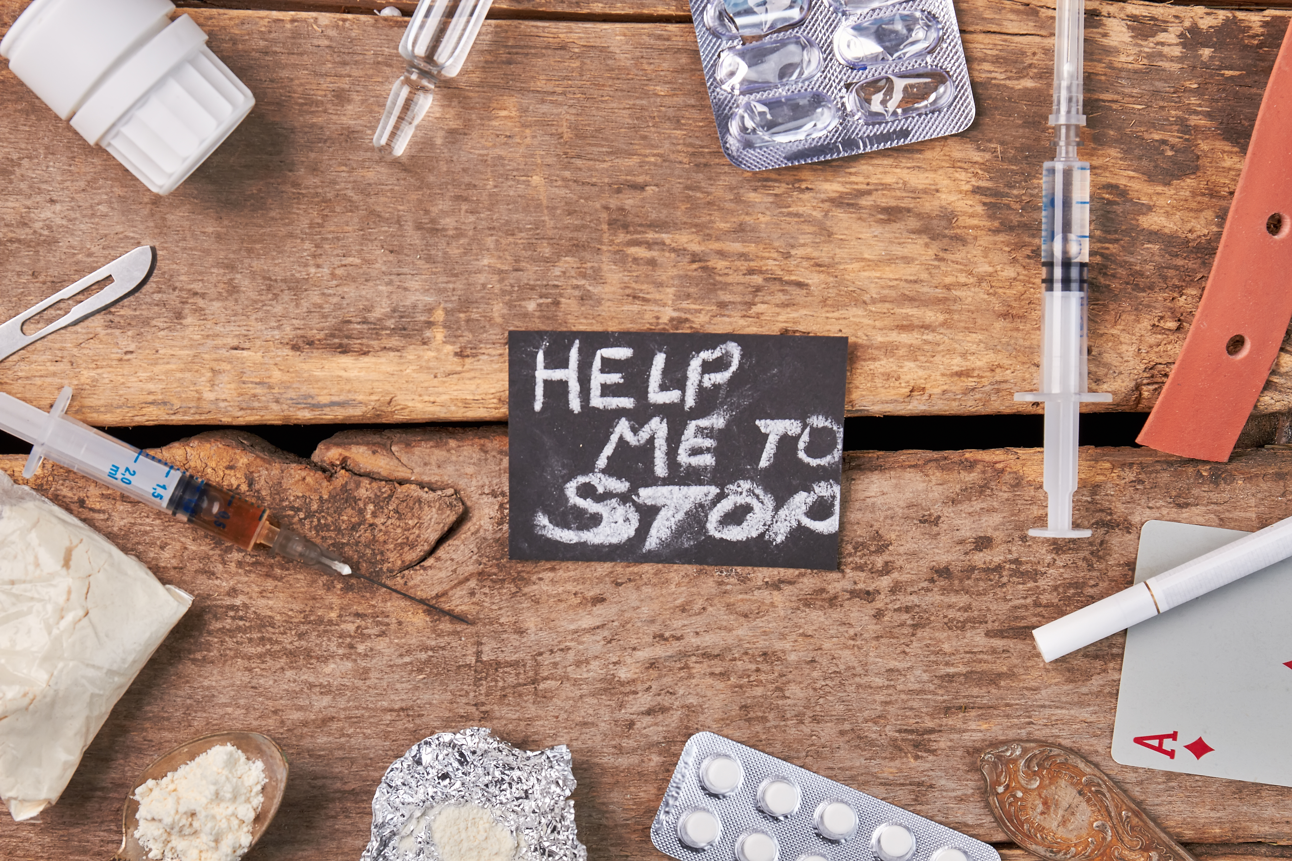
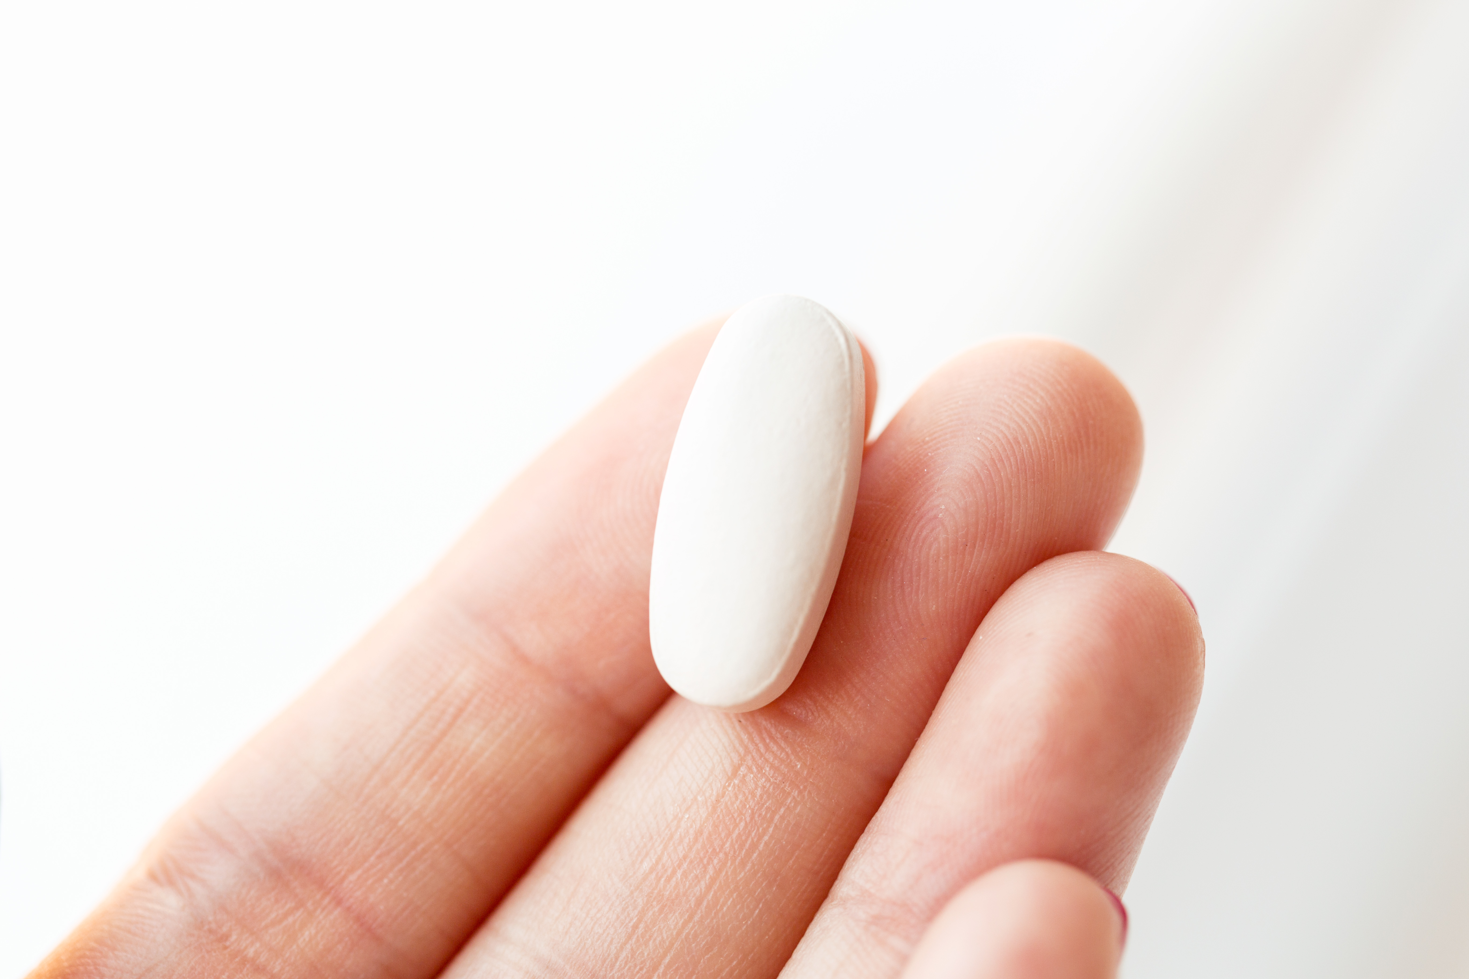
Prescribing trends

Slide 5
Opiate prescription's 2006-2020

Slide 6
Prescriptions USA vs TN

Slide 7
Top Prescribed Drugs By Year

Slide 8
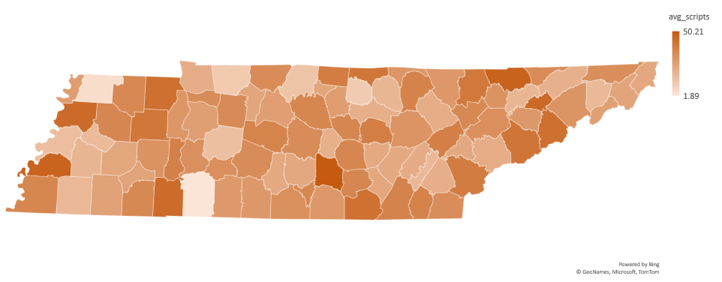
Prescriptions by county
Per 100 people

Slide 9
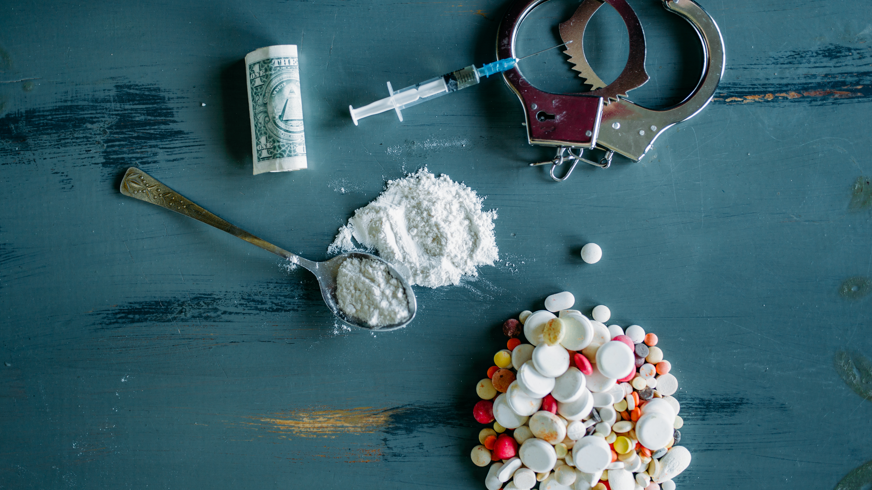
Fatal overdoses

Slide 10
Fatal overdoses 2013-2020

Slide 11
Fatal overdoses USA 1980-2020

Slide 12
Fatal OD BY Drug and Year

Slide 13
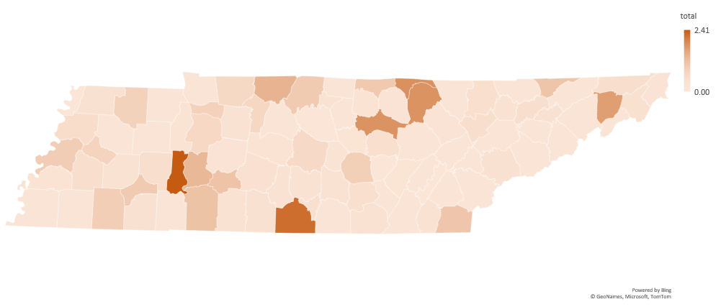
Fatal BY County
Per 100 people

Slide 14

The way to get started is to quit talking and begin doing.
Walt Disney
Non Fatal Overdoses
Fatal overdoses

Slide 15
Non-Fatal overdoses 2013-2020

Slide 16
Non-fatal OD by drug and year

Slide 17
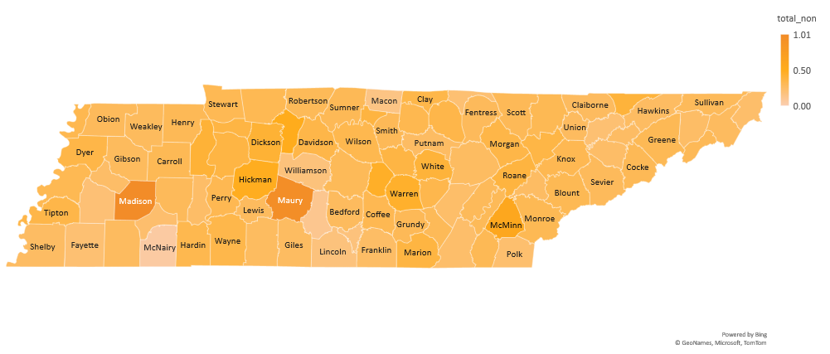
Non-fatal by county
Per 100 people

Slide 18
In Conclusion

Slide 19
Challenges
The state didn’t start tracking until 2016
US prescription data isn’t broken down by drug
All data for prescribing habits of opiates begins at 2006
Non-Fatal OD data doe not separate out fentanyl
VA doesn’t supply the state with their scripts or OD information

Slide 20
References
Data Sources
Tools used
Articles quoted
https://www.cdc.gov/
https://www.census.gov/
https://www.tn.gov/
SQL
Python
Power Point
Excel
https://www.ncbi.nlm.nih.gov/pmc/articles/PMC2622774/

Slide 21


Thank you
Christian Alsider
christianlalsider@gmail.com
www.linkedin.com/in/christianalsider

